Slide 1

HR Analytics: Job change of Data Scientists
By Sowndarya
Ijas Muhammed
Thanushree
Vignesh
Lokesh
Alankrat gupta

Slide 2
ABOUT THE DATASET
A company which is active in Big Data and Data Science wants to hire data scientists among people who successfully pass some courses which are conducted by the company. Many people signup for their training. Company wants to know which of these candidates really wants to work for the company after training or looking for a new employment as it helps to reduce not only the cost and time as well as the quality of training , planning the courses and categorization of candidates.
By model(s) that uses the current credentials,demographics,experience data we will predict the probability of a candidate to look for a new job or will work for the company, as well as interpreting affected factors on employee decision.

Slide 3
Features
enrollee_id : Unique ID for candidate
city : City code
city_ development _index : Development index of the city (scaled)
Gender : Gender of candidate
relevent_experience : Relevant experience of candidate
enrolled_university : Type of University course enrolled if any
education_level : Education level of candidate
major_discipline : Education major discipline of candidate
experience : Candidate total experience in years
company_size : No of employees in current employer's company
company_type : Type of current employer
lastnewjob : Difference in years between previous job and current job
training_hours : Training hours completed
target: 0 – Not looking for job change, 1 – Looking for a job change

Slide 4
METHODOLOGY
Data Collection
EDA
Models
Predictions

Slide 5

Data Collection
HR Analytics data chosen for this project is taken from Kaggle. We used pandas read_csv() function to load the data to the notebook. This dataset comes with both categorical and numerical data which has been cleaned and processed to build the model.
Information related to demographics, education, experience is taken from candidates signup and enrollment

Slide 6
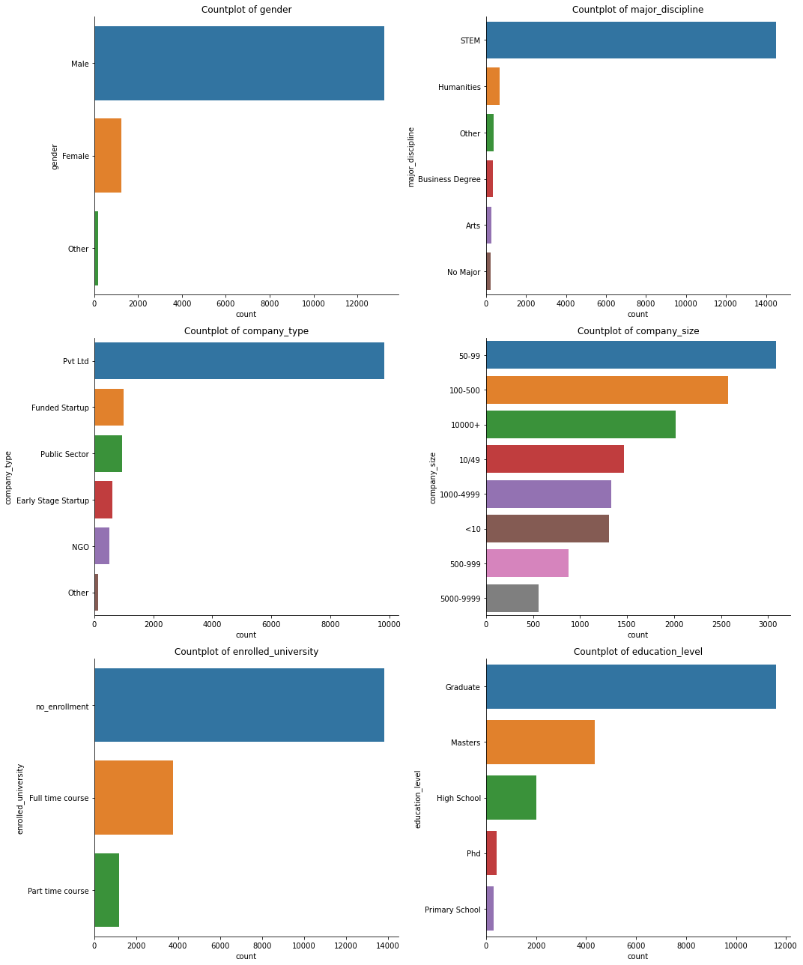
Exploratory Data Analysis
Missing value treatment : We used isnull() function on our dataset to find the missing values.
We replaced the missing values in features like gender, enrolled_university, major_discipline, experience, company_size, last_new_job, company_type, education_level with their mode .

Slide 7
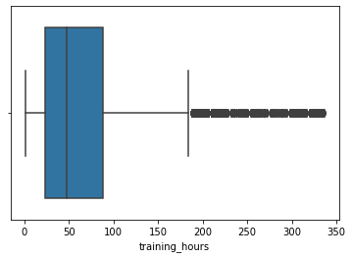
Outlier Treatment
We treated the outliers in training hours feature using IQR(Inter Quartile Range)

Slide 8

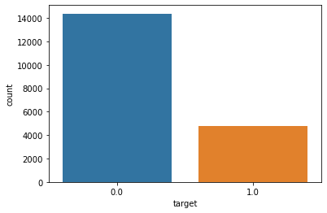
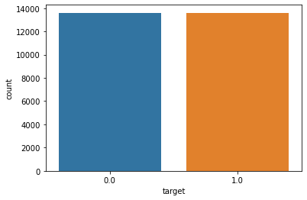
Data Preprocessing
We have to Convert all the ‘Categorical’ or ‘Object’ datatypes to ‘Numeric’ using label encoder. further go for Model Building having target as the Target Variable and remaining as Independent Variables.
using SMOTE Techniques
Class imbalance is a scenario that arises when we have unequal distribution of class in a dataset i.e. the no. of data points in the negative class (majority class) very large compared to that of the positive class (minority class).
Then Finally after Scaling the data using Standard Scaler we will go for Model Building using all the Necessary Algorithms

Slide 9
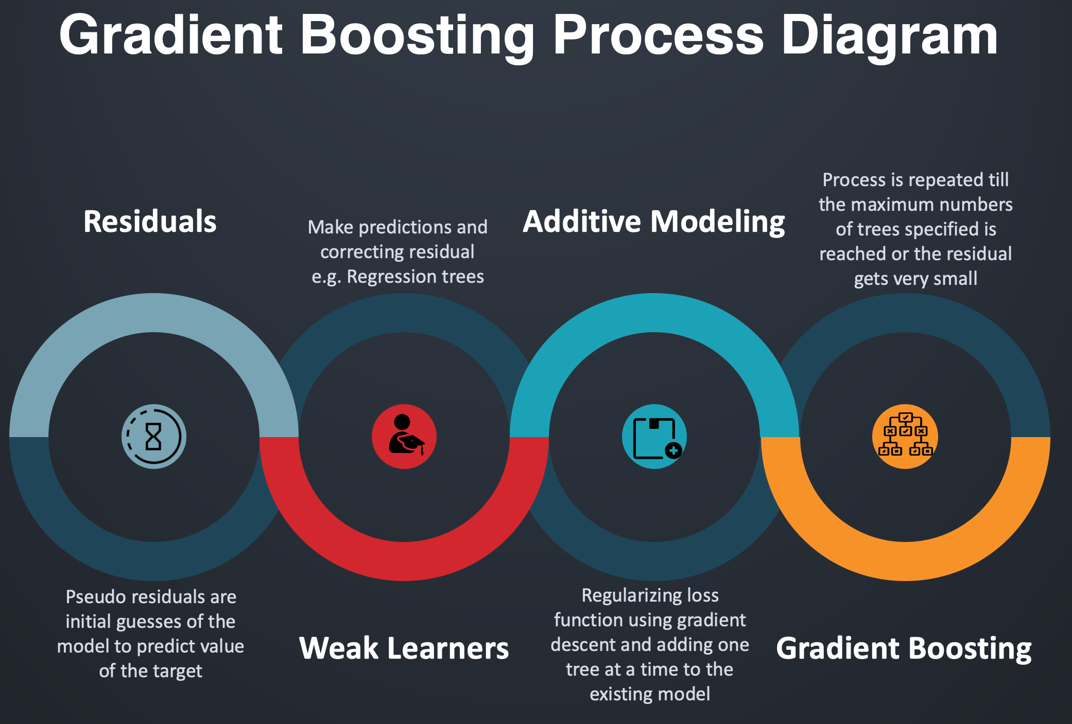
MODELS
We divided the data as train and test set using train_test_split() function.
We imported the required libraries for the models used
Models built were:
KNN
XtremeGradientBoost
Decision Tree
Random Forest

Slide 10
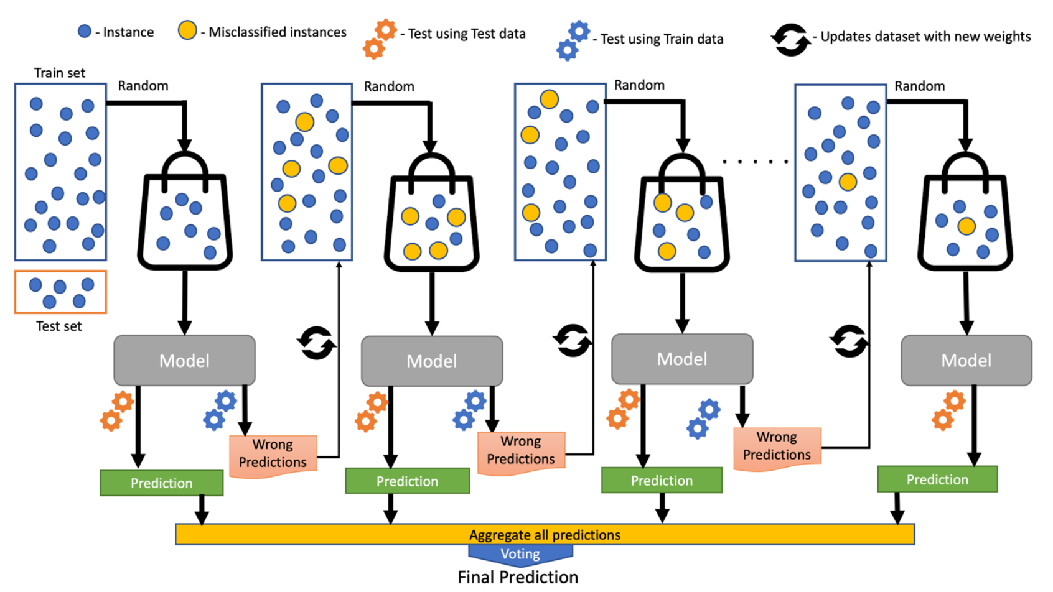
Final Conclusion
This was an incredibly learning experience iterating on building a predictive House Price model.
By building model using “XGBRegressor” we got the model with lowest “RMSE” of 0.13 and “r2_score Accuracy of 98.30%. So, we can conclude that our “House Price Model” is accurate as predicted.
So from the data we can get the proper Price of house as per our Requirement.
And in Future with the new data the model should perform good

Slide 11


